Slide 1

jarred capellman | 4.19.2019

Slide 2



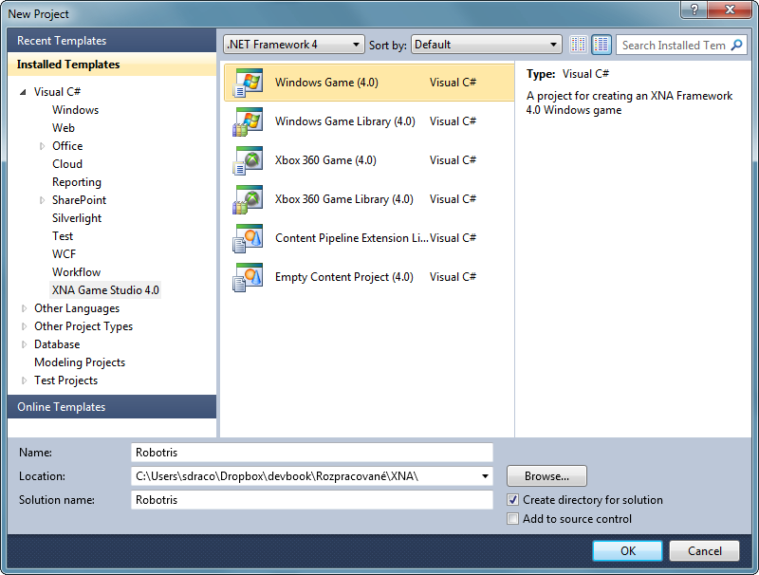




What is MonoGame?

Slide 3








Targeted platforms
PS4, Xbox One and Nintendo Switch require developer program registration

Slide 4


Published MonoGame Titles (1000+)

Slide 5
MonoGame Structure
Content Pipeline
Game Class
Rendering
Input
Updates

Slide 6
CREATING A GAME WITH MONOGAME

Slide 7
High Level Game Design Questions
Perspective
2D
3D
Control Mechanisms
Mouse
Keyboard
Controller
Targeted platforms
Mobile
Console
Desktop

Slide 8

Things to keep in mind
Resolution Scaling
Use Highest Resolution Assets available
Architect up front
Long term time savings
Playtest early and often

Slide 9
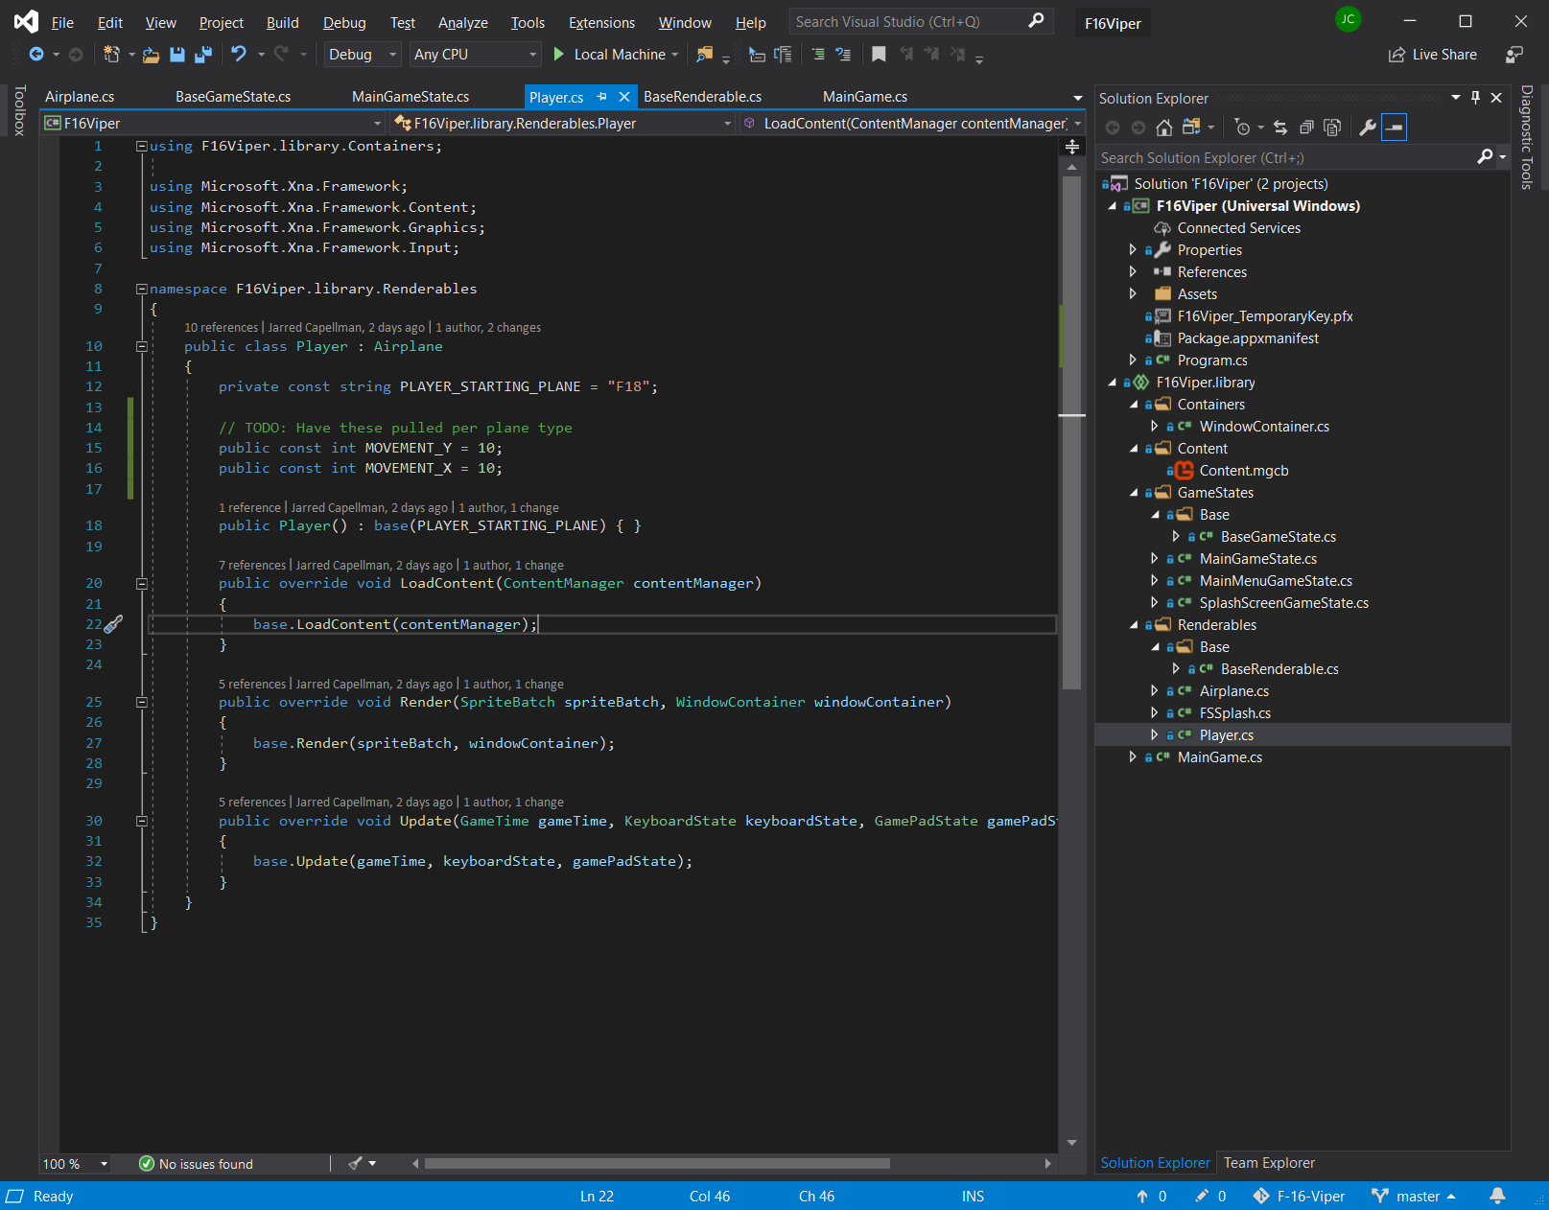
demo | code deep dive

Slide 10
MonoGame Resources
A new book coming later this year (From beginner to advanced)
GitHub:
https://github.com/MonoGame/MonoGame.Samples

